Slide 1


MY SQL PROJECT
PRESENTED BY:
~ BY AMOGH

Slide 2


INTRODUCTION
MySQL is a widely used Relational Database Management System (RDBMS) that helps store, organize, and manage data in the form of tables. It uses Structured Query Language (SQL) to perform operations such as creating databases, inserting records, updating data, deleting records, and retrieving information.
MySQL was developed by MySQL AB and is now owned by Oracle Corporation. It is open-source, which means it is free to use and can be modified according to user needs.
OBJECTIVE
THE OBJECTIVE OF THIS:
* Design a relational database in MySQL
* Create three related tables
* Insert 500 records into each table
* Perform business-oriented data analysis using SQL
* Generate insights from sales data

Slide 3

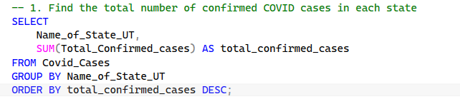
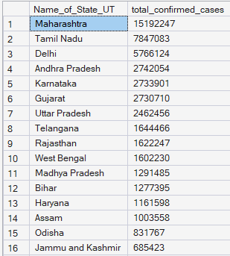
QUERY TO ACCESS CSV FILE IMPORTED IN SSML
QUERIES TO SOLVE WITH THEIR OUTPUT

Slide 4
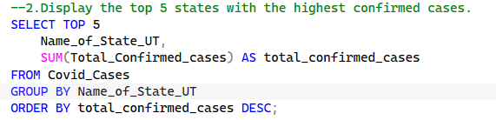
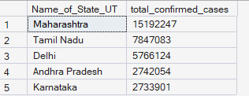
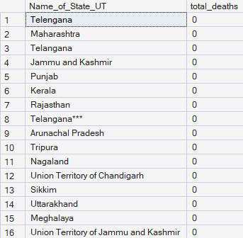
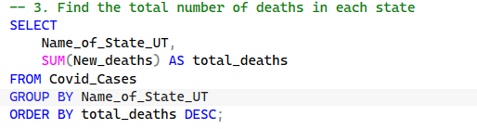
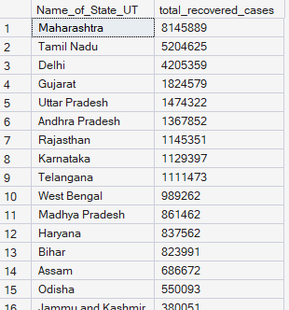
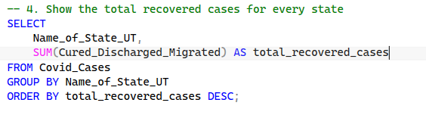

Slide 5
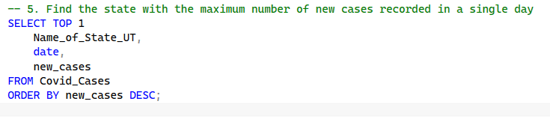

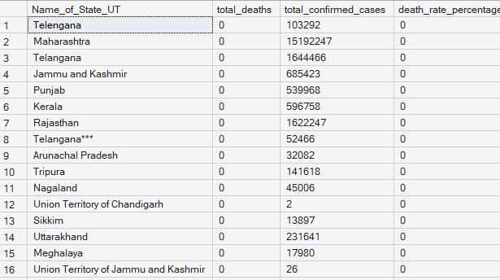
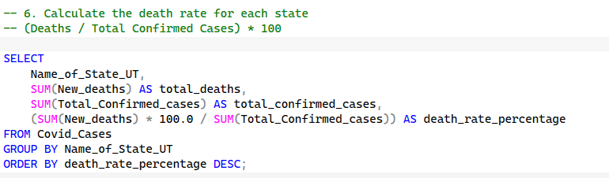
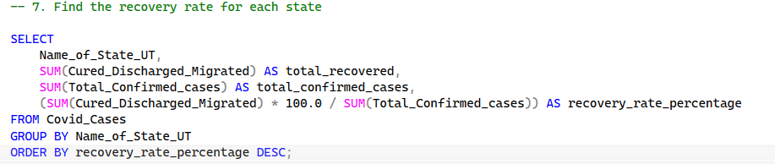
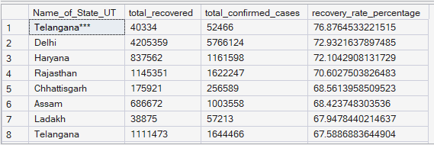

Slide 6
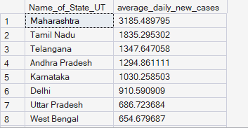
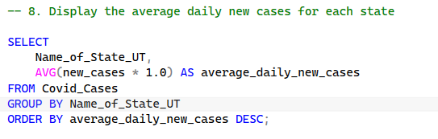
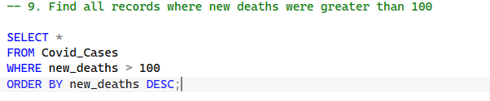

Slide 7
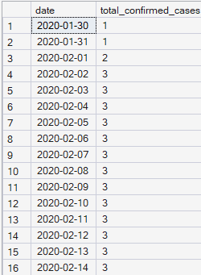
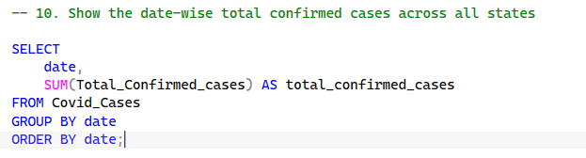
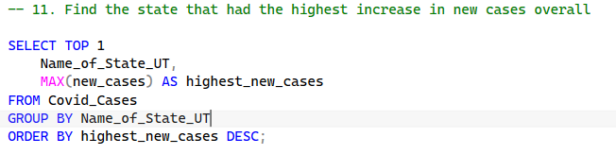

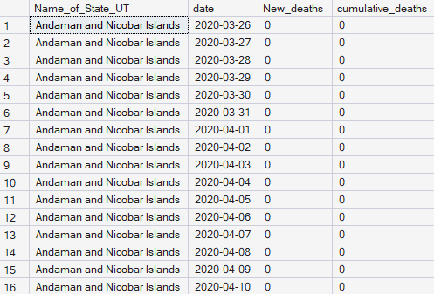
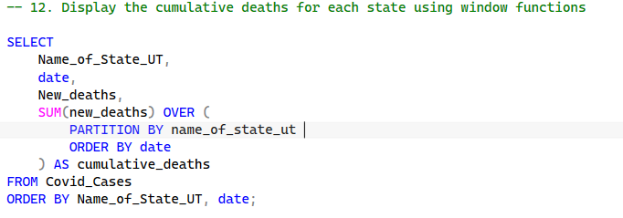

Slide 8
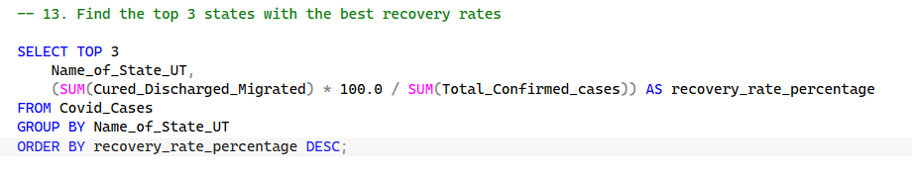
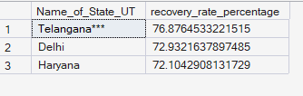
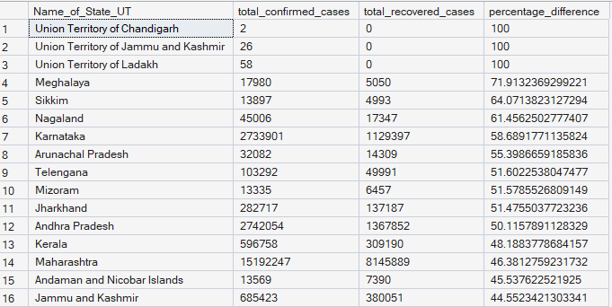
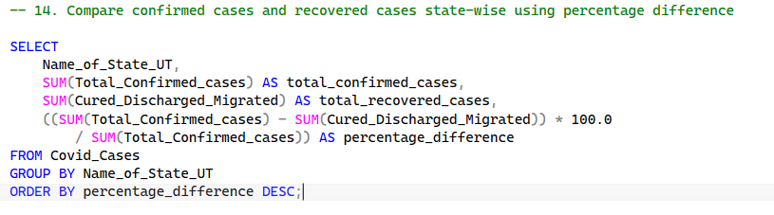
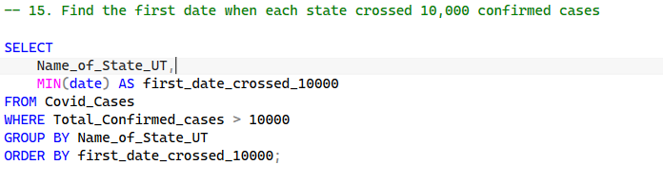
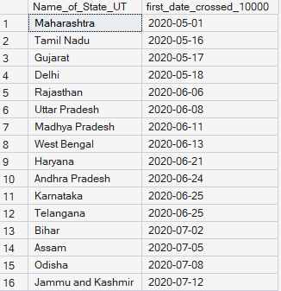

Slide 9
KEY FINDINGS
MAJOR OBSERVATIONS
->States with highest confirmed cases were identified.
->Recovery rates varied significantly across states.
->Some states maintained lower death rates.
->Daily case trends showed pandemic growth patterns.
->Window functions provided cumulative analysis.

Slide 10

CONCLUSION
This project demonstrates how SQL can transform raw COVID-19 data into meaningful insights. By using aggregate functions, grouping, filtering, and window functions, important trends and statistics were identified.

